Slide 1
Burden and management of AUD and co occurring mental disorder
Catherine Abbo, MBchB, MMED( Psych), Cert/Mphil( Child and Adolescent Psychiatry, PhD
Associate Professor
Dept of Psychiatry, MakCHS
Raymond Odokonyero( MBchB, MMED(Psych)
Lecturer
Dept of Psychiatry, MakCHS
Kenneth Kalani( MBchB, MMED(Psych)
Senior Medical Officer, MOH

Slide 2
Outline of presentation
Introduction
Definitions
Risk Factors for Dual Diagnosis
Diagnostic Challenges
Management Models
Clinical, Research and Policy Implications
Conclusion

Slide 3
Introduction
Young people: People aged 10–24 years (according to UNICEF,WHO, and UNFPA). Information from the UN Department of Economic and Social Aff airs.
Alcohol use: Refers to use of alcohol
Alcohol use problem( Harmful use) occurs when using alcohol causes harm( Health, school/work or social relationships) to the user or to others.
Alcohol abuse: A pattern of repeated alcohol use that often interferes with health, work or social relationships.
Alcohol use problems can lead to addiction/Dependency.
Notes:
Adolescent: people aged 10–19 years (according to UNICEF,
WHO, and UN Population Fund [UNFPA]).*
Young people: people aged 10–24 years (according to UNICEF,
WHO, and UNFPA).*
Youth: people aged 15–24 years (by UNICEF, WHO, UNFPA, and
UN Secretariat), or 15–32 years (by UN Habitat [youth fund]).*
Child: people aged <18 years (UNICEF, on the basis of the
Convention on Rights of the Child).*

Slide 4
Introduction
Alcohol:
a small molecule widely distributed throughout the body
affects most of the body’s organs and systems.
As a psychoactive substance has harmful impact on mental health through:
intoxication,
physical ,
psychological dependence
withdrawal states,
detrimental effect on cognitive and affective functioning.
AUD are one of the most prevalent comorbidities in people with mental illness.
Notes:
As alcohol is a small molecule that is widely distributed throughout the body, it can cause myriad harms affecting most of the body’s organs and systems.
As a psychoactive substance, alcohol has a particularly harmful impact on mental health, through intoxication, physical and psychological dependence and withdrawal states, as well as having a detrimental effect on cognitive and affective functioning.
AUD are one of the most prevalent comorbidities in people with mental illness

Slide 5
Alcohol use occurs along a continuum
Begins to have negative consequences e.g impaired driving
What else to do to feel good, better, do better, satisfy curiosity and social pressure
Compulsive drinking despite negative consequences
Young people trying out, because friends are doing it Does not last long, not often , depends on availability, location, group of friends, family bonding
Recreational/Casual/Negligible health or social consequences
Experiment
Casual
/NP use
Prob use/Abuse
Dependency/Addiction
No use
Notes:
Misuse: For purposes of getting drunk or high, use for any other purpose other than the intended purpose
Continuum concept helps in putting in developmental perspective of the young person and progression to Substance Use Disorder

Slide 6
Introduction
Uganda has one of the highest annual consumption of alcohol in Africa.
In 2016, the per capita consumption of pure alcohol by people aged 15 years and above, was 26.0 liters(Ref).
Regular heavy use of alcohol has a spectrum of adverse outcomes including psychological, physical, social, and legal problems.
Among young people in Uganda, alcohol use is normative but often leads to the maladaptive patterns of use that characterize alcohol use disorder (AUD

Slide 7
Dual Diagnosis
Moreover, AUD among young people often co-occurs with mental disorders, a condition commonly referred to as Dual Diagnosis(DD).
DD are common and a serious public health concern.
Among patients attending mental health services in low and middle-income countries (LMICs) such as Uganda,
AUD is a major co-occurrence that makes clinical care challenging.

Slide 8
Dual Diagnosis
DD among young people is associated with
functional impairment in various life domains,
physical health problems,
relational conflicts,
educational/vocational underachievement, and
legal problems.
Several challenges exist in delivering effective treatment to such young people with co-occurring mental disorders and AUD, resulting in a tremendous economic burden on healthcare, educational, and justice systems.

Slide 9
Objectives
From literature review and experiences of the authors of this paper, the objectives of this paper are
to describe:
Risk Factors for Dual Diagnosis in young people
Diagnostic Challenges
Management models
Discuss Clinical, Research and Policy implications of Dual Diagnosis in young people

Slide 10
Risk Factors for DD
Multfactorial and interactional
Genes x Environmental factors
no clear directional pattern indicating whether mental disorders or AUDs come first.
Most Young People, MD preceeds AUD
Earlier onset of Alcohol use tends to confer worse outcomes.
Understand why Young People use alcohol helps in Understanding the Risk Factors
AUD Risk and Protective Factors
MD Risk and Protective Factors
Shared
Notes:
Like most complex psychiatric disorders, the risk factors for the development of a dual diagnosis are multifactorial and include overlapping genetic vulnerabilities and environmental factors (Hawkins 1992).
There is no clear directional pattern indicating whether mental disorders or SUDs come first.
However, in most adolescents with a dual diagnosis, a mental disorder typically precedes problematic substance use, and small subsets of young people develop a SUD before experiencing a mental disorder (Merikangas 2010).
Earlier onset of substance use tends to confer worse outcomes.
Understanding the reasons why young people use substances can be a helpful way to understand their risks

Slide 11
Risk Factors- hypothesis the explain developmental pathway
common aetiological factors (risk factors common to both disorders),
MD
Self Medication
Coping with
symptoms
Shared Risk Factors
Genetic Predisposition and/or social or environmental factors e.g adverse life events, social economic status
Negative
consequences
AUD
bidirectional feedback (presence of mental disorder can contribute to the development of SUD and vice versa),
Notes:
Common aetiological factors The common factors hypothesis has been used to explain the coexistence of substance use disorder with conditions such as attention-deficit hyperactivity disorder or schizophrenia. For instance, the hypothesis suggests that there is a common genetic determinant of risk for schizophrenia within neural systems (dopaminergic and glutamatergic), that contributes to the risk for both psychosis and addiction to substances (Khokhar 2018). Most substances of misuse increase dopaminergic activity in the brain and can mimic or exacerbate psychotic symptoms. Bidirectional feedback Since neurocircuitry vulnerability may arise prior to the appearance of psychotic symptoms, an increased use of substances in adolescence may both increase the risk for developing a later SUD and serve as an additional risk factor for the appearance of psychotic symptoms (bidirectional hypothesis). Through a positive feedback loop, one of the components of the coexisting disorders serves to sustain or worsen the other in reciprocal fashion (Khokhar 2018)
Secondary mental disorder The secondary mental disorder hypothesis proposes that substance misuse precipitates mental disorder. Several meta-analyses and prospective studies have demonstrated that adolescent cannabis use is associated with increased risk of psychosis even after adjustment for baseline prodromal symptoms, parental psychosis and other substance use (Mustonen 2018). Self-medication The ‘self-medication hypothesis’ posits that substance misuse in people with mental disorders is the resultant effect of the desire to ameliorate their psychiatric symptoms (Khantzian 1997). For instance, someone who has experienced childhood adversity or witnessed domestic violence may develop depression or anxiety disorder and may be inclined to use cannabis to alleviate their symptoms. Although the self-medication hypothesis is plausible and attractive to patients and clinicians, empirical studies have not reported any strong relationship between symptoms of mental disorders and substance use (DeQuardo 1994). Furthermore, adolescents with a dual diagnosis seldom report that specific substances alleviate specific symptoms of a particular mental disorder. Environmental risk factors Research findings have identified several environmental factors relevant to the cumulative risk of development of a dual diagnosis in young people. These include prenatal exposure to alcohol and psychoactive substances, low birth weight, anoxia and brain damage at birth, childhood temperament, high levels of emotional reactivity and impulsivity, and parental attitudes of permissiveness towards use of substances by young people (Hawkins 1992). Intellectual disability, school exclusion, family conflict, adverse childhood experiences and witnessing domestic violence are also significantly associated with increased substance use and development of a mental disorder. Association with regular drug-using peers increases the likelihood of substance use in adolescents. Dual diagnosis is also overrepresented in the homeless population, prisons and the lesbian, gay, bisexual and transgender (LGBT) community (Catchpole 2

Slide 12
Prevention of DD in young people
Resilience
Characteristics that enhance normal development in difficult conditions
12
Protective factors can reduce the risk acts as buffers to the negative effects of adversity or risk factors
Risk Factors/adversity
Increase the person’s chances for substance abuse
Factors intrinsic
Aim: Occurrence of new cases by Risk and Vulnerability factors and/ or protective and resilience factors (Begun ,1993)
Vulnerability
Characteristics of the child, the family, wider community which might threaten or challenge healthy development

Slide 13
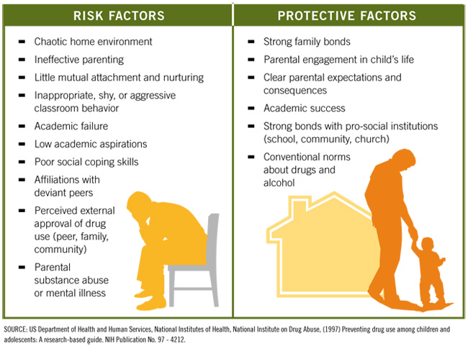

Slide 14
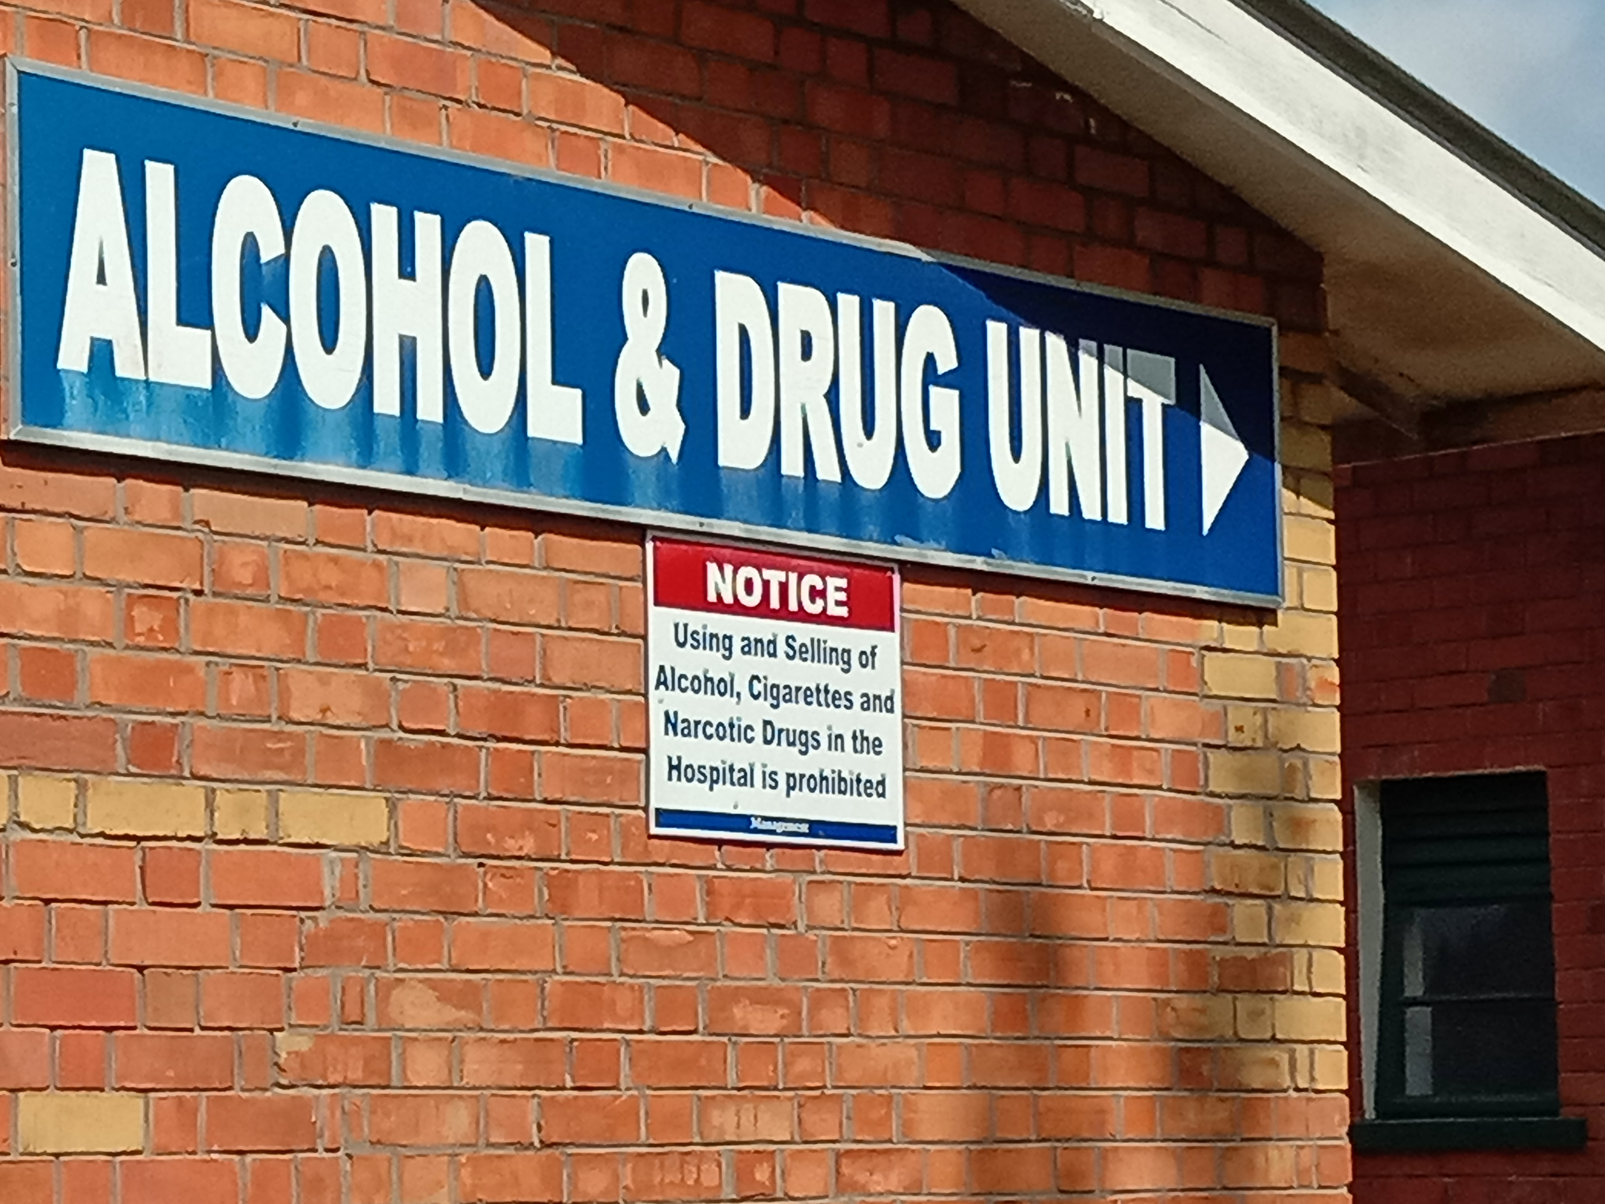
Alcohol and Drug Unit-Butabika Hospital
Admissions Jan –June 2019
73 patients
Male: 67 (91.7%)
Female 6(8.3%)
Age below 24 years: 36( 49.3%)
Male: 33(91.7%)
Female: 3(8.3%)
Occupation: student 31(86%)

Slide 15
ADU Diagnoses
15
Single substance
use
Comorbidities
Multiple SUD
Alcohol and PTSD
Alcohol and Depression
Alcohol and Epilepsy
Alcohol, depression and personality Disorder
Alcohol induced psychosis
Alcohol, marijuana, cocaine
Tobacco, marijuana, alcohol
Alcohol ,Nicotine
Heroine, cannabis, nicotine
Marijuana, alcohol, tobacco
Alcohol, marijuana
Alcohol, nicotine
Benzhexol, Nicotine
Cannabis
Alcohol
Heroine
11/23/2022

Slide 16
Diagnostic Challenges
Dual Diagnosis
Alcohol and PTSD
Alcohol and Depression
Alcohol and Epilepsy
Alcohol, depression and personality Disorder
Alcohol induced psychosis
History
variable combination of MD and AUD
there is no single symptom or group of symptoms common to all combinations.
The symptoms of one problem can resemble, mask or exacerbate the symptoms of the other.
Accepting DD
The presence of a dual diagnosis increases severity and complicates recovery –Non adherent to treatment,
Notes:
owing to the variable combination of mental illness and substance use problems, there is no single symptom or group of symptoms common to all combinations.
The symptoms of one problem can resemble, mask or exacerbate the symptoms of the other.
The presence of a dual diagnosis increases severity and complicates recovery

Slide 17
Diagnostic challenges
Is it Alcohol Induced Disorder or DD?
In clinical practice, it is often difficult to differentiate Alcohol-induced disorders from dual diagnosis because most young people are usually not able to achieve the lengthy abstinence from alcohol that is required for a formal diagnosis.
For this reason, diagnosis of DD needs to be flexible.
Symptoms may change with maturity, a decrease in alcohol use, prolonged abstinence or level of environmental stress.
Notes:
In clinical practice, it is often difficult to differentiate Alcohol-induced disorders from dual diagnosis because most young people are usually not able to achieve the lengthy abstinence from alcohol that is required for a formal diagnosis.
For this reason, diagnosis of mental disorder needs to be flexible. Symptoms may change with maturity, a decrease in alcohol use, prolonged abstinence or level of environmental stress.

Slide 18
Probe use of alcohol
Take collateral history
Review medical records
Look for evidence on P/E
Review Lab tests
Patient’s Concerns:
I am seeing things; people are following me; sad; anxious
18
Consider a possible role of alcohol
YES
Diagnosable MD OR symptoms of MD
NO
Diagnosable MD
Symptoms only
Detox, abstinence, support,
Treat AUD, Watchful waiting
Distinguish btwn Alcohol induced
and Comorbid D/O
Comorbid Disorder
Dual Diagnosis
Alcohol Induced Disorder
Detox, Rehabilitation( abstinence, Support,
Aftecare, Relapse Prevention)
Treat both Disorders
simultaneously
11/23/2022
Remain flexible with working Diagnosis and follow up

Slide 19
Challenges with service delivery
There are a number of challenges in delivering effective treatment to patients with DD.
The complexity of issues makes diagnosis, care and treatment more difficult.
Patients become at higher risk of relapse, (re)admission to hospital and harm to self or others.
One key issue is the number of mushrooming rehabilitation centres without effective guidelines and control of standards, no cordination, no proper referral pathway
can result in treatment becoming fragmented and duplicated, leading to a poorer experience for the patient and ineffective management of risk

Slide 20
Management Models
3
1
2
Sequential/serial treatment First, the patient is offered treatment for either the mental disorder or the substance use disorder. After successfully completing treatment for one disorder, they are offered treatment for the other.
Simultaneous/parallel treatment The patient receives treatment for both the mental disorder and the substance use disorder at the same time, but the treatment is offered by different services, primarily in isolation from each other.
Integrated service The patient benefits from the coordinated use of a single treatment plan that focuses on the two conditions simultaneously and uses multiple treatments, such as the combination of psychotherapy and pharmacotherapy

Slide 21
Clinical Implications
Increased workload for the clinician , need to screen all young people clinicians interphase with for MD and AUD
advantage of screening
possibility of providing early intervention for the most prevalent co-occurring psychiatric disorders, such as MD and depression,
early detection of emerging MD that may not reach a diagnostic threshold.

Slide 22
Research implications
Are mental health services adequately assess for dual diagnosis in young people?
Are evidence-based treatment protocols for young people with a dual diagnosis in use?
Culturally and developmentally appropriate approaches?

Slide 23
Policy implications
the ‘no wrong door’ approach. The principle of the ‘no wrong door’ approach ensures that the patient is supported or linked to appropriate services regardless of where they enter the system of care.
policy to ensure services working with young people with coexisting MD and AUD deliver evidenced based care and treatment in a clinically coordinated and systematic manner.
This will ensure young people with co-existing MD and AUD and their carers and families receive appropriate and effective services equipped to meet their needs.
Notes:
Young people with a dual diagnosis are vulnerable individuals who are typically involved with multiple services, including the juvenile justice system, thus highlighting the need for collaboration and coordination of services

Slide 24
Conclusion
Alcohol Use typrically starts in adolescence, a time when noticeble signs of MDs appear
DD causes morbidity in young people with a number of diagnostic and management challenges that have clinical, Research and Policy implications

Slide 25
References
Armstrong TD, Costello EJ. Community studies on adolescent substance use, abuse, or dependence and psychiatric comorbidity. J Consult Clin Psychol. 2002;70(6):1224–39.
Bender K, Springer DW, Kim JS. Treatment effectiveness with dually diagnosed adolescents: a systematic review. Brief Treat Crisis Interv. 2006;6(3):177–205.
Deas D. Adolescent substance abuse and psychiatric comorbidities. J Clin Psychiatry. 2006;67(Suppl 7):18–23.

Slide 26
Thank you!

